Slide 1



SMART MIRROR using raspberry pi
Final Year Project

Slide 2

Main Components
TFT monitor 14inch
Wooden frame
APIs
RASPBERRY PI 3
Two way mirror

Slide 3
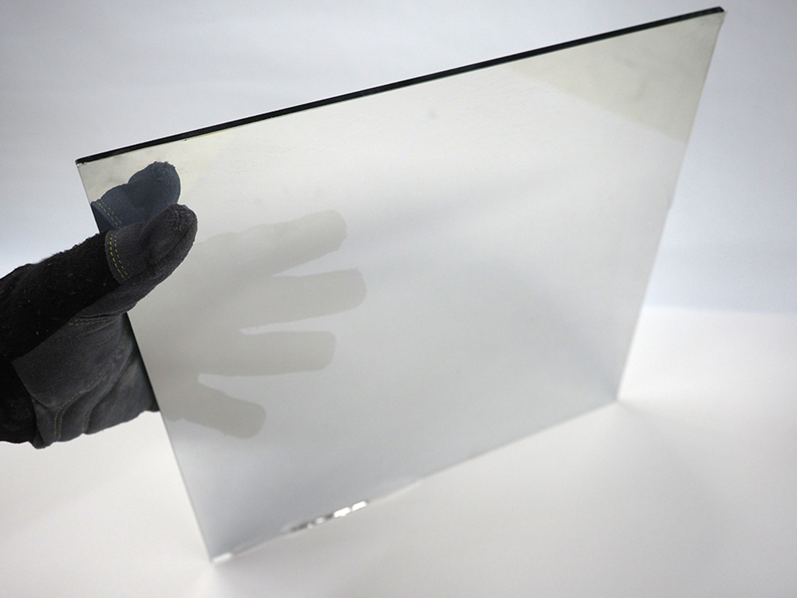
Two way mirror
A one-way mirror, also called two-way mirror, is a reciprocal mirror that is reflective on one side and transparent at the other. The perception of one-way transmission is achieved when one side of the mirror is brightly lit and the other side is dark. This allows viewing from the side that is lightened but not by the darkened side.

Slide 4

TFT dIsplay
A thin-film-transistor liquid-crystal display (TFT LCD) is a variant of a liquid-crystal display (LCD) that uses thin-film-transistor (TFT) technology to improve image qualities such as addressability and contrast. A TFT LCD is an active matrix LCD, in contrast to passive matrix LCDs or simple, direct-driven LCDs with a few segments.
TFT LCDs are used in appliances including television sets, computer monitors, mobile phones, handheld devices, video game systems, personal digital assistants, navigation systems, projectors,^{[1]} and car instrument clusters.

Slide 5
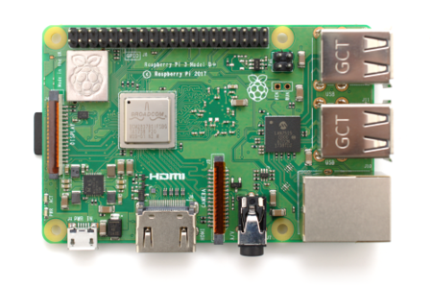
Raspberry pi 3
Raspberry Pi is a series of small single-board computers developed in the United Kingdom by the Raspberry Pi Foundation to promote teaching of basic computer science in schools and in developing countries. The original model became far more popular than anticipated, selling outside its target market for uses such as robotics. It does not include peripherals (such as keyboards and mice) and cases. However, some accessories have been included in several official and unofficial bundles
CPU1.4 GHz 64/32-bit quad-core ARM Cortex-A53Memory1 GB LPDDR2 RAM at 900 MHz^{[3]}StorageMicroSDHC slotGraphicsBroadcom VideoCore IV 300 MHz/400 MHzPower1.5 W

Slide 6
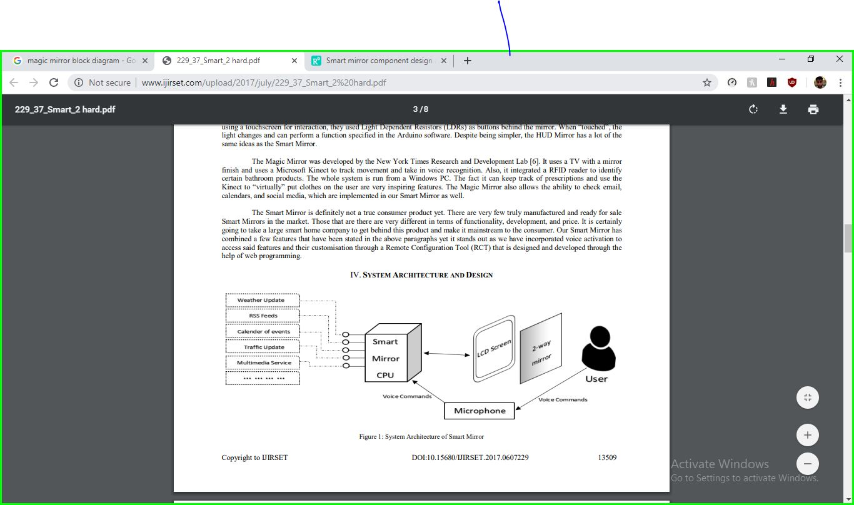
BLOCK dIAGRAM

Slide 7
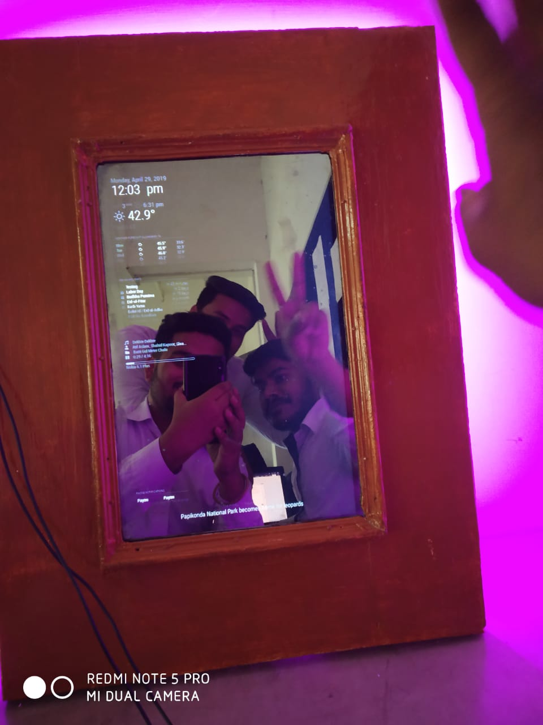
Wooden frame
Dimensions:
Outside : 24x18inch
Inside : 15inch diagonally

Slide 8

Process
RPI
TFT
Two Way Mirror
Python & JSS & EMbedded

Slide 9
Features & Modules
MMM-Scrobbler – Displays the music you are currently listening to, if you are using last.fm (Which I recommend as a data nerd)
MMM-AlexaPi / MMM-Awesome-Alexa – Make your mirror even more awesome by integrating it with Amazon’s Alexa voice assistant
Phone notifications – Show your phone notifications on your mirror.
MMM-Remote Control – Control your magic mirror through a web interface on your laptop or smartphone. Very handy!
MMM-PIR-Sensor – Put your mirror to sleep if there is no motion detected. You’ll need to buy a PIR sensor module and hook it up to your pi. You can find these dirt cheap online. Here are a couple of options:
HC-SR501 Pir Motion IR Sensor Module
Adafruit PIR Motion Sensor
MMM-Admin Interface – Gives you a very nice looking web app to control you mirror. It’s similar to the Remote control module but a bit more robust

Slide 10

Thank you
Group no. 23

